Slide 1

Project Title
Healthcare Analytics for Doctor Visits
Presented By
Sahil Rushikant Mahadik

Slide 2

PROBLEM STATEMENT
Healthcare for doctor visits datasets contain large amounts of patient and doctor visit information.
Analyzing these factors together to understand patient visit pattern is challenging.
It is difficult to identify how age, gender, illness, and health status influence doctor visits.
The relationship between chronic conditions, reduced activity, and healthcare utilization needs to be examined.
Data analysis and visualization are required to identify meaningful patterns and insights from patient healthcare data.

Slide 3
PROJECT DESCRIPTION
Collected and analyzed healthcare data of patients and doctor visits.
Performed Exploratory Data Analysis (EDA) to understand the dataset.
Analyzed patient visits based on age, gender, illness, and health status.
Studied chronic conditions and reduced activity among patients.
Created visualizations to identify important healthcare patterns and insights

Slide 4

WHO ARE THE END USERS?
Healthcare Professionals: To understand patient visit patterns.
Hospitals & Clinics : To analyze patient and healthcare trends.
Healthcare Analysts: To generate insights from healthcare data.
Researchers: To study healthcare patterns and patient behavior.
Healthcare Management: To support data driven decisions.

Slide 5

Technology Used
  Python
  Google Colab
  Libraries:
    NumPy
    Pandas
    Matplotlib
    Seaborn

Slide 6
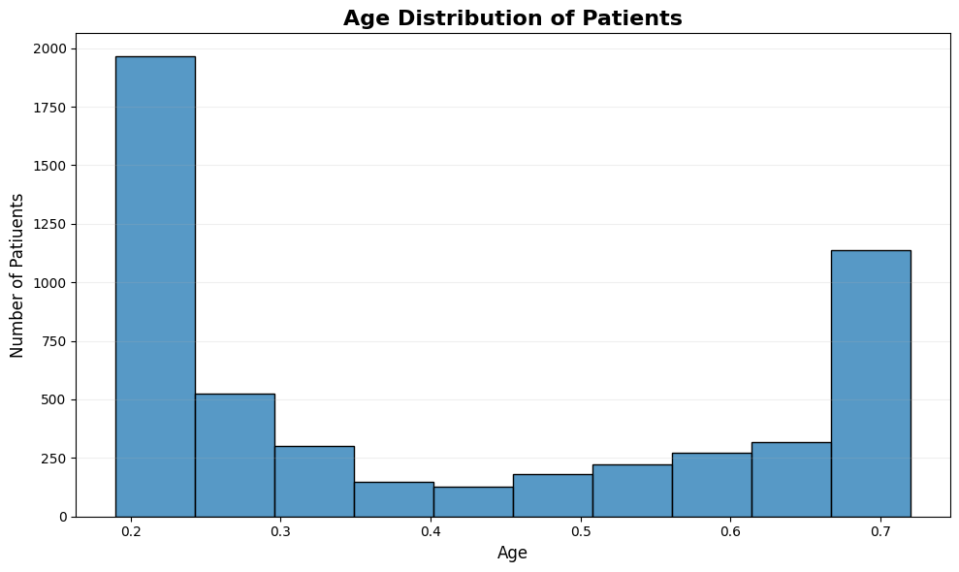
RESULTS
1. Histogram – Age Distribution

Slide 7
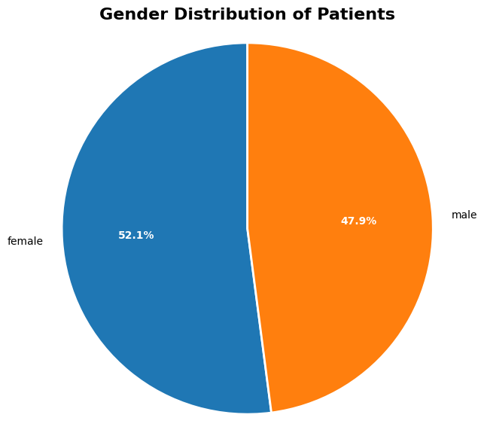
RESULTS
2. Pie Chart – Gender Distribution of Patients

Slide 8
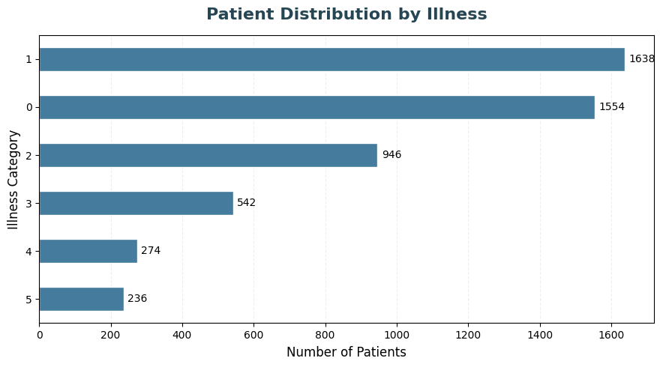
RESULTS
3. Horizontal Bar Chart – Patient Distribution by illness

Slide 9
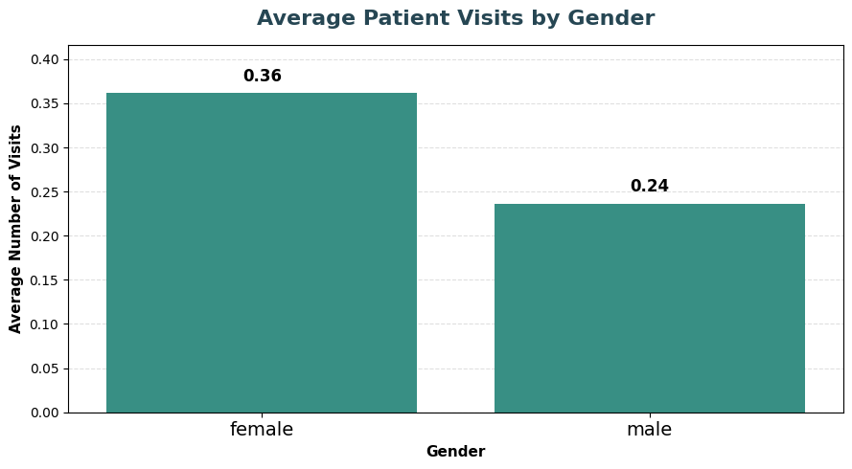
RESULTS
4. Bar Chart – Average Patient Visits by Gender

Slide 10
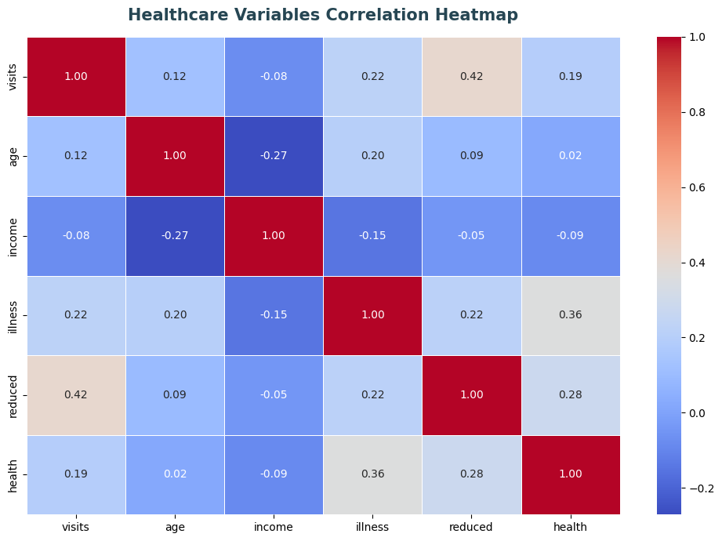
RESULTS
5. Heatmap – Healthcare Variables Correlation
GitHub Demo Link

Slide 11
Thank You!
.
.

